Slide 1
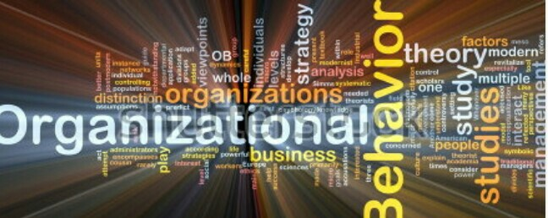

Slide 2
TOPIC:GLOBAL IMPLICATION-VALUES AND PERSONALITY

Slide 3
CONTENTS
Introduction.
Defining Personality
The Myers-Briggs type indicator.
The Big Five Personality model.
Values.
Global Implications.
Conclusion.
References.

Slide 4
INTRODUCTION
Personality is the sum total of ways in which an individual reacts to and interacts with others.
Most often describes in the terms that a person exhibits such as shy, aggressive, lazy, ambitious etc.
Values refers to people’s stable life goals, reflecting what is most important to them.
Values are established throughout as a result of accumulating life experiences, and relatively stables.

Slide 5
What is personality?
The dynamic organization within the individual of those psychophysical systems that determine his unique adjustments to his environment(Allport)
Enduring characteristics that describe an individuals behavior.
Two dominant frameworks used to describe personality.
-Myers-Briggs Type Indicator
- Big Five Model

Slide 6
THE MYERS-BRIGGS TYPE INDICATOR
Most widely used instrument in this world.
Participants are classified on four axes to determine on of the 16 personality types as ENTJ.

Slide 7
BIG FIVE MODEL OF PERSONALITY

Slide 8
VALUES
Values represent basic, enduring convictions that a “specific mode of conduct or end-state of existence is personally or socially preferable to an opposite or converse mode of conduct or end-state of existence.

Slide 9
IMPORTANCE OF VALUES
Provide understanding of attitudes, motivation and behavior.
Influence our perception of the world around us.
Represent interpretations of “right” and “wrong”.
Imply that some behaviors or outcomes are preferred over others.

Slide 10
GLOBAL IMPLICATIONS
PERSONALITY
The Big Five transfer across culture, but the frequency of the type in the culture may vary.
Better in individualistic than collectivistic culture.
VALUES
Values differ across culture.
Hofstede’s framework of assessing culture-Five value dimensions
Power Distance
Individualism vs. Collectivism
Masculinity vs. Feminity
Uncertainty avoidance
Long term vs. Short term Orientation.

Slide 11
CONCLUSIONS
Define the personality.
Myers Briggs Type Indicator.
Big Five Model.
Define values.
Global Implications.

Slide 12
REFERENCES
Robinson.S.P.Judge,T.A.,Vohra,N Organizational Behavior,XIV edn.,Prentice-Hall,India.
https://www.enotes.com
https://books.google.co.in.

